Slide 1
AWS Lambda
Pravin Y Pawar

Slide 2

AWS Lambda
Run code without thinking about servers or clusters. Only pay for what you use.
AWS Lambda is a serverless compute service that allows to run code
without provisioning or managing servers
creating workload-aware cluster scaling logic
maintaining event integrations
or managing runtimes
With Lambda, one can run code for virtually any type of application or backend service
all with zero administration
Just upload code as a ZIP file or container image, and Lambda
automatically and precisely allocates compute execution power
runs code based on the incoming request or event, for any scale of traffic
Can write Lambda functions in favorite language (Node.js, Python, Go, Java, and more)
use both serverless and container tools, such as AWS SAM or Docker CLI, to build, test, and deploy functions

Slide 3
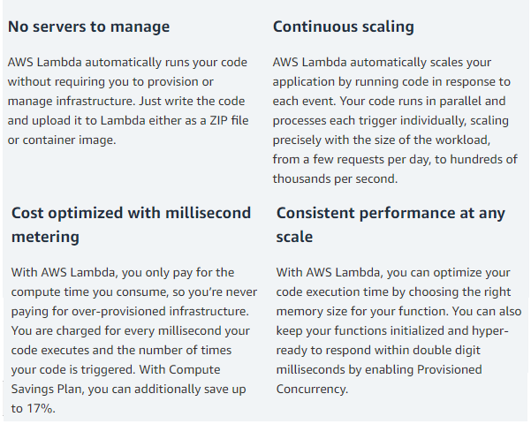
Benefits

Slide 4
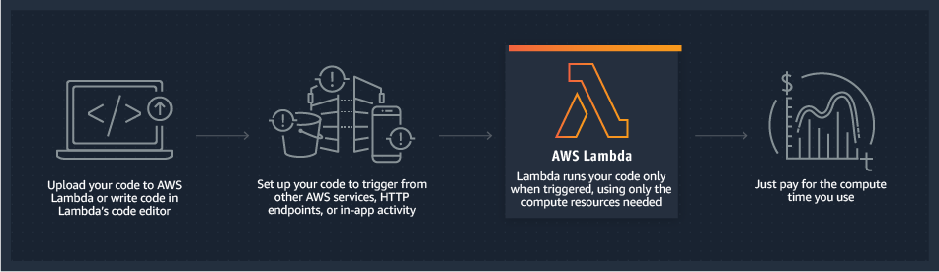
How it works?

Slide 5
Use cases
What can you build with AWS Lambda?
Backends
Can build serverless backends using AWS Lambda to handle
web
mobile
Internet of Things (IoT)
and 3rd party API requests
Can take advantage of Lambda’s consistent performance controls, such as multiple memory configurations and Provisioned Concurrency
for building latency-sensitive applications at any scale
Data processing
Can use AWS Lambda to execute code in response to triggers such as
changes in data
shifts in system state
or actions by users
Lambda
can be directly triggered by AWS services such as S3, DynamoDB, Kinesis, SNS, and CloudWatch
can connect to existing EFS file systems, or it can be orchestrated into workflows by AWS Step Functions
allows to build a variety of real-time serverless data processing systems

Slide 6
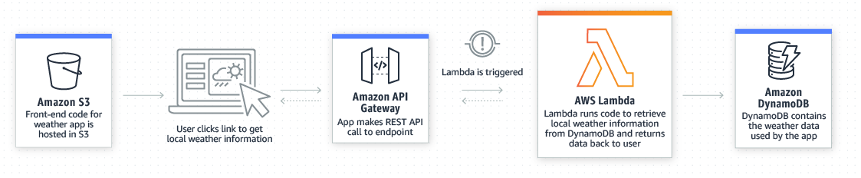
Use case
Backends - Web applications
By combining AWS Lambda with other AWS services, developers can build powerful web applications
that automatically scale up and down and run in a highly available configuration across multiple data centers
with zero administrative effort required for scalability, back-ups or multi-data center redundancy

Slide 7
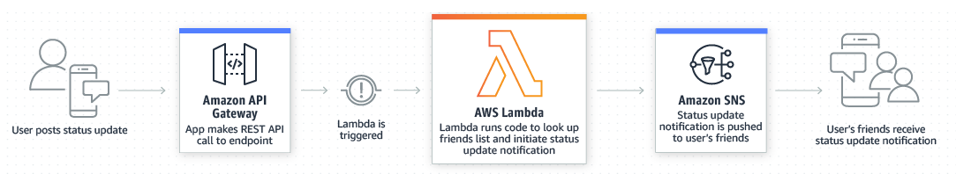
Use case (2)
Backends - Mobile backends
AWS Lambda makes it easy to create rich, personalized app experiences
Can build backends using AWS Lambda and Amazon API Gateway to authenticate and process API requests
Can use AWS Amplify to easily integrate backend with your iOS, Android, Web, and React Native frontends

Slide 8
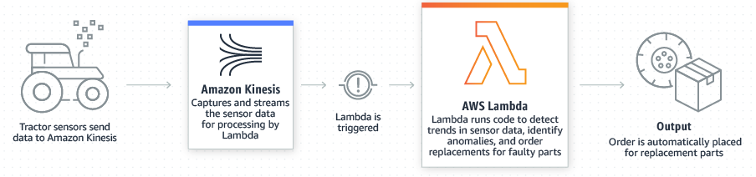
Use case (3)
Backends - IoT backends
Can build serverless backends using AWS Lambda to handle
web
mobile
Internet of Things (IoT)
and 3rd party API requests

Slide 9
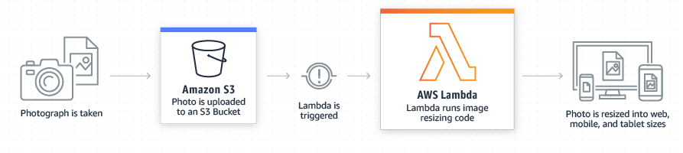
Use case (4)
Data processing - Real-time file processing
Can use Amazon S3 to trigger AWS Lambda to process data immediately after an upload
Can also connect to an existing Amazon EFS file system directly
enabling massively parallel shared access for large scale file processing
Can use Lambda to
thumbnail images
transcode videos
index files
process logs
validate content
and aggregate and filter data in real-time

Slide 10
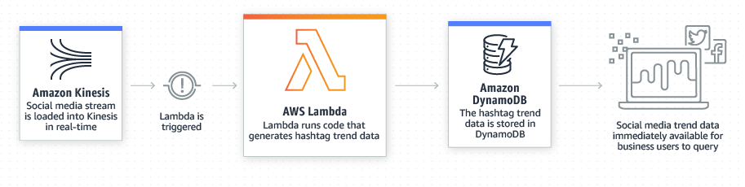
Use case (5)
Data processing - Real-time stream processing
Can use AWS Lambda and Amazon Kinesis to process real-time streaming data for
application activity tracking
transaction order processing
click stream analysis
data cleansing
metrics generation
log filtering
indexing, social media analysis
and IoT device data telemetry and metering

Slide 11
Thank You!
Reference :
AWS Serverless
In our next session:

